Slide 1


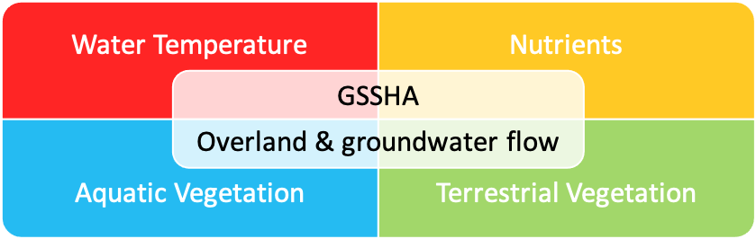
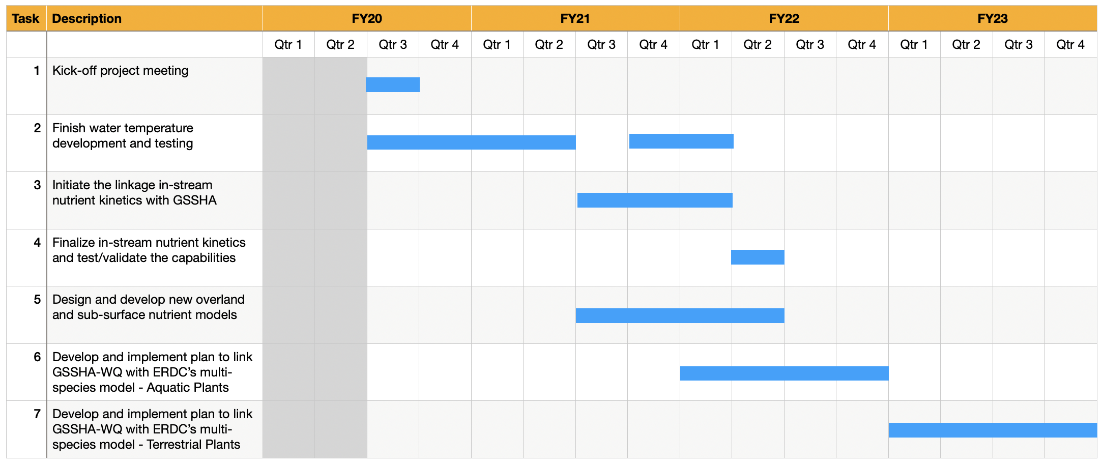
Incorporating nutrient flow into overland flow and groundwater models to better predict ecological response across large scales Todd Steissberg (Todd.E.Steissberg@usace.army.mil, 530-574-5572)
Billy Johnson (LimnoTech), John Kucharski (EL), Charles Downer (CHL), Nawa Pradhan (CHL), Zhonglong Zhang (PSU), Lora Johnson (EL)
Problem Statement
Technical Approach Cont’d
Current models cannot simulate nutrient flow across watershed scales, which prevents accurate prediction of how native and nuisance species will spatially distribute themselves across a landscape. Objective: Incorporate nutrient flow into the Gridded Surface Sub-surface Hydrologic Analysis (GSSHA) model and couple the nutrient model with ERDC's multi-species vegetation models.
Phase II. Integrated nutrient & vegetation simulation capabilities
Link the GSSHA-WQ with ERDC’s multi-species vegetation model for aquatic plants
Link the GSSHA-WQ with ERDC’s multi-species vegetation model for terrestrial plants
Technical Approach
Schedule
Phase I. Water quality simulation capabilities (GSSHA-WQ)
Complete/extend existing water temperature simulation capabilities in GSSHA for overland flow (runoff) & streams
Temperature controls water quality kinetics rates
Link in-stream nutrient kinetics with GSSHA
Nutrient Simulation Module (NSM) provides kinetics
Develop overland and sub-surface nutrient models
ANSRP Ecological Modeling Congressional Interest

Slide 2
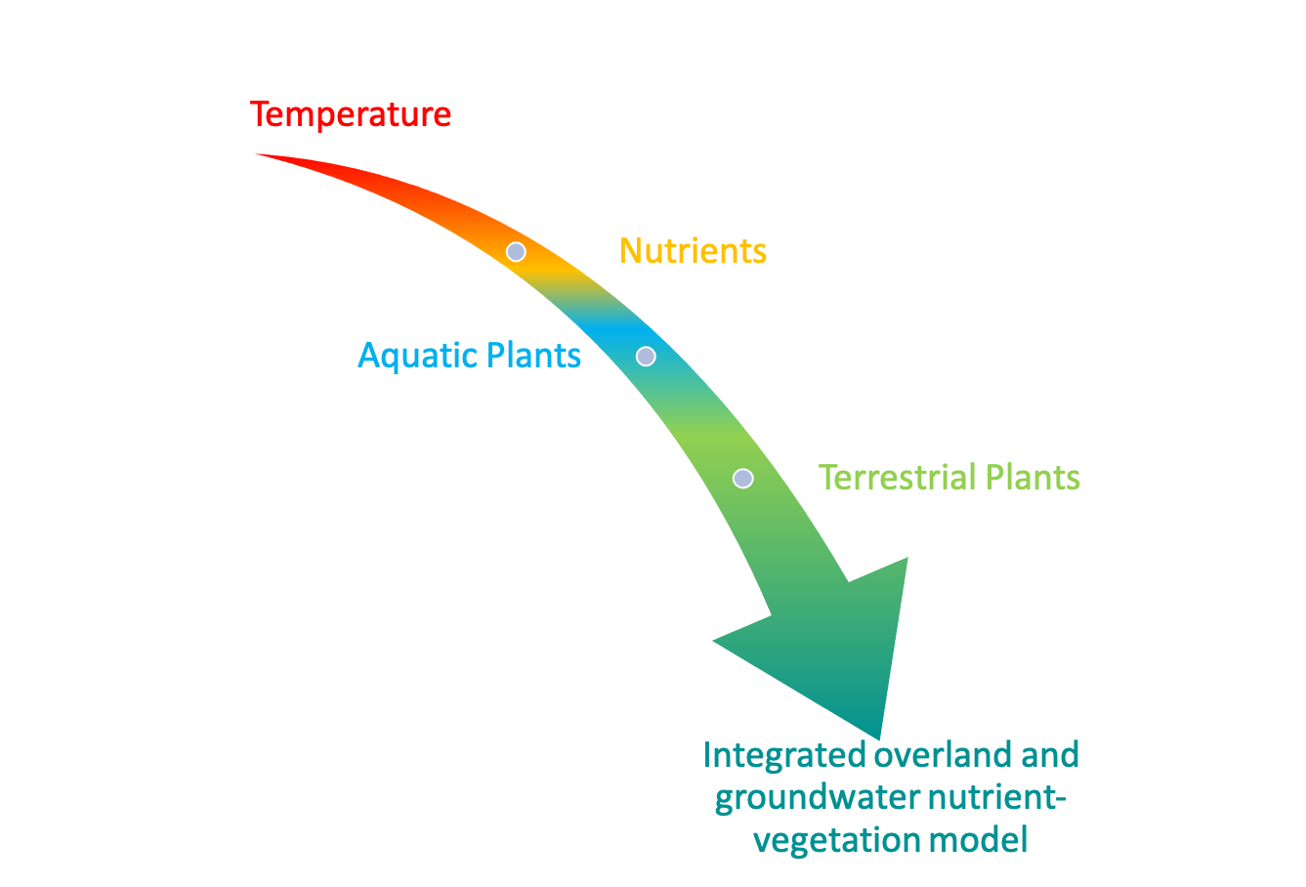
Incorporating nutrient flow into overland flow and groundwater models to better predict ecological response across large scales Todd Steissberg (Todd.E.Steissberg@usace.army.mil, 530-574-5572)
Billy Johnson (LimnoTech), John Kucharski (EL), Charles Downer (CHL), Nawa Pradhan (CHL), Zhonglong Zhang (PSU), Lora Johnson (EL)
Forecasting Project Hurdles
Value statement for USACE operations
Data exchange between models
Observed data for calibration/validation (flow, water quality, and vegetation)
Use existing data, but may require travel in FY22-23
Integrating nutrient flow with multi-species vegetation models will enable accurate simulation of native and nuisance species distribution across watersheds.
Next Steps
Data exchange between models
Observed data for calibration/validation (flow, water quality, and vegetation)
Use existing data, but may require travel in FY22-23
Finish water temperature development and testing
Complete in-stream nutrient kinetics development
Complete overland and sub-surface nutrient kinetics
Design and implement linkage of temperature and nutrient flow with the aquatic vegetation model
Budget by Q/Year
 | Qtr1 | Qtr2 | Qtr3 | Qtr4
FY20 | 0 | 25 | 125 | 150
FY21 | 75 | 75 | 75 | 75
FY22 | 75 | 75 | 75 | 75
FY23 | 75 | 75 | 75 | 75
ANSRP Ecological Modeling Congressional Interest

Slide 3
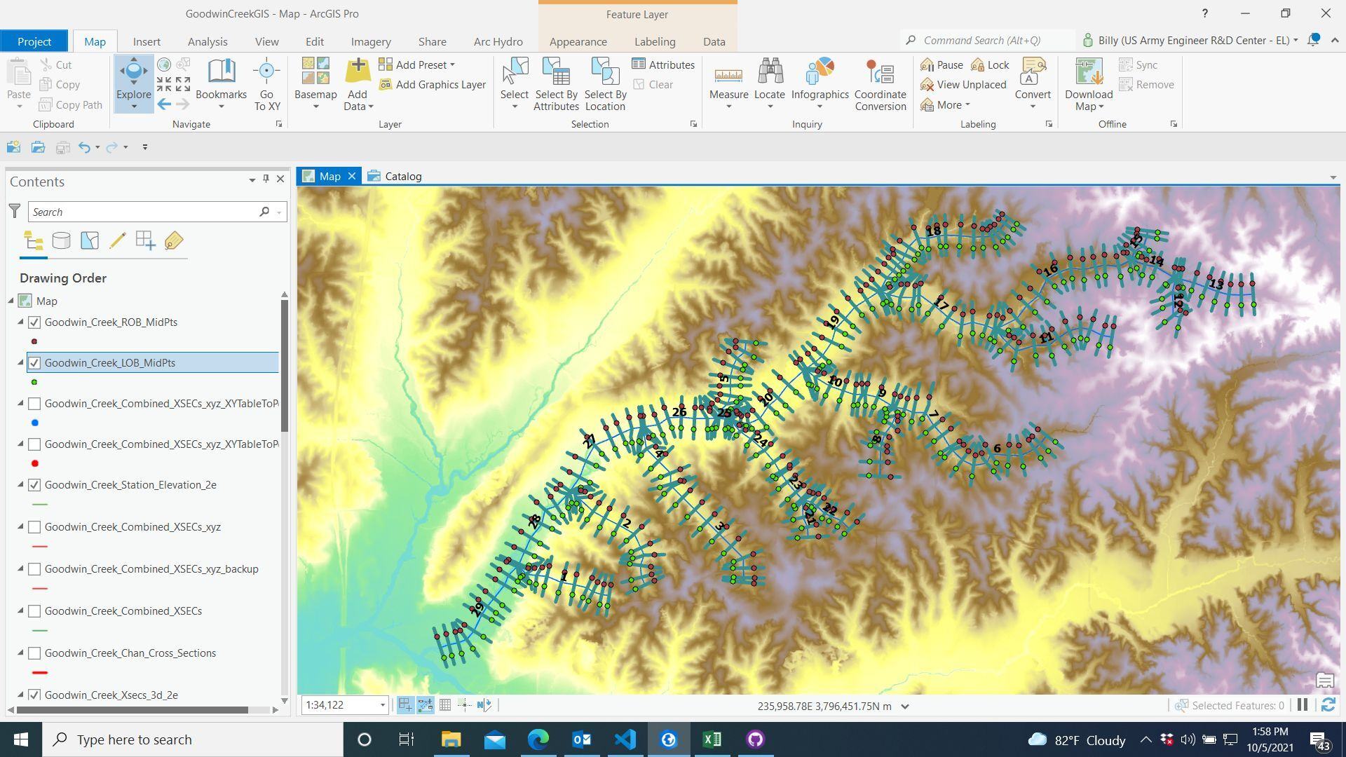
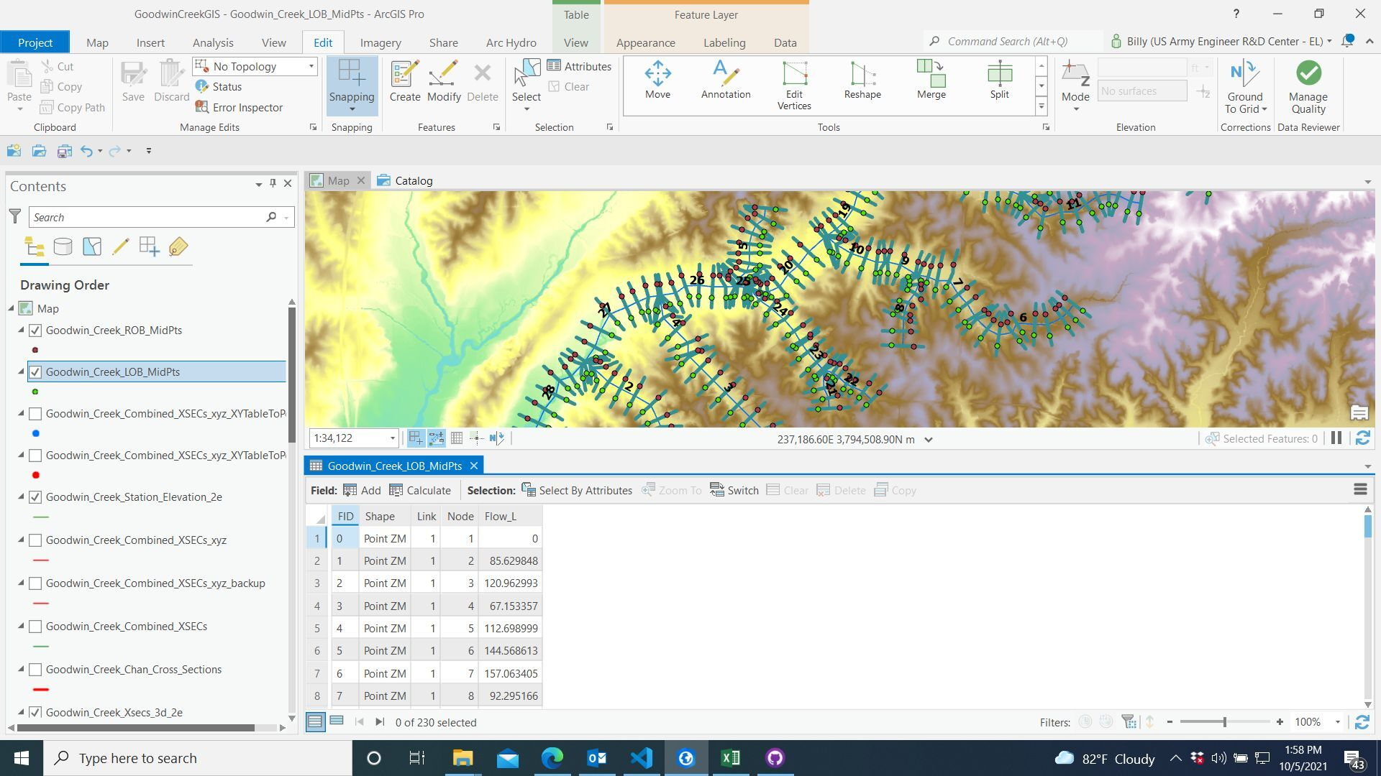
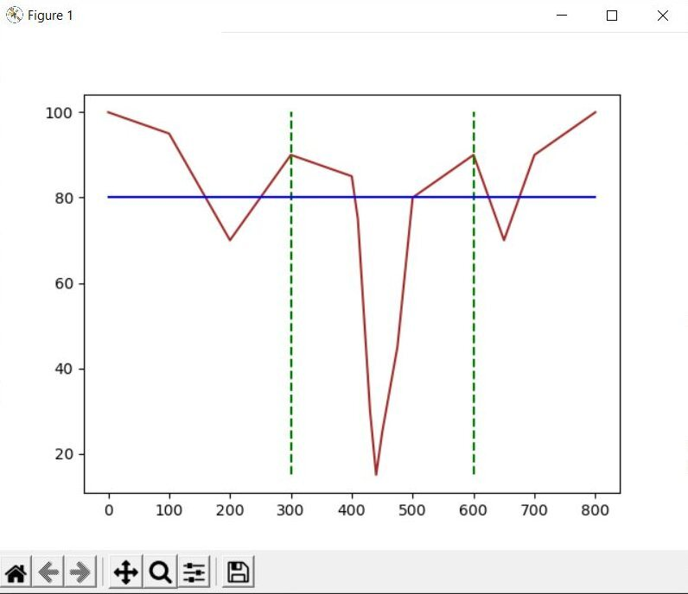
Incorporating nutrient flow into overland flow and groundwater models to better predict ecological response across large scales Todd Steissberg (Todd.E.Steissberg@usace.army.mil, 530-574-5572)
Billy Johnson (LimnoTech), John Kucharski (EL), Charles Downer (CHL), Nawa Pradhan (CHL), Zhonglong Zhang (PSU), Lora Johnson (EL)
Deliverable Tracking
Successes/Results
Implemented initial water temperature algorithm in GSSHA
Designed and developed programs to export GSSHA data to be used by the water quality and vegetation models
Developed streamlined versions of the Temperature and Nutrient simulation modules (TSM and NSM) in Python
Designed methodology for extending the ClearWater-Riverine modeling tool to handle GSSHA input data (geometry and flows) and link the data with the 2D water quality simulation capabilities and the aquatic and vegetation module
FY20: Contracts awarded, WQ development initiated
FY21-22: GSSHA-WQ model capable of simulating overland and stream water temperature and nutrient flow
FY22: GSSHA-WQ linked with aquatic plants model; 6 technical notes
FY23: GSSHA-WQ linked with terrestrial plants model; final product; 4 technical notes
ANSRP Ecological Modeling Congressional Interest

